Slide 1
18-799: Applied Computer Vision Spring 2026
Image Formation

Slide 2
Objectives
In today’s class we will learn
Homogeneous Coordinates and transformation
Geometric primitive
Geometric Image formation
Photometric image formation

Slide 3
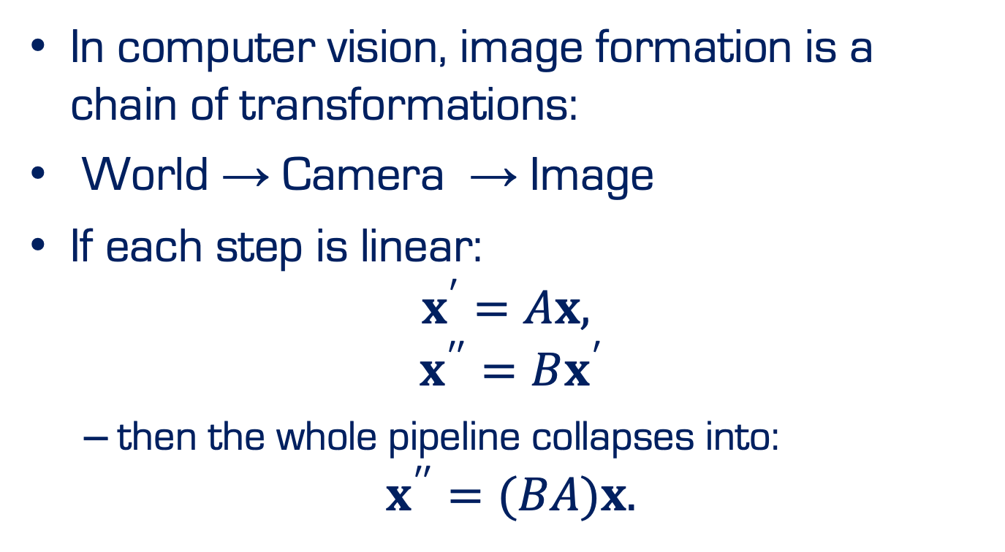
Homogeneous Coordinates
In computer vision, image formation is a chain of transformations:
$\text{World}\text{ → }\text{Camera} \text{→ }\text{Image}$
If each step is linear:
$$x^{′}=Ax,$$
$$x^{′′}=Bx^{′}$$
then the whole pipeline collapses into:
$$x^{′′}=(BA)x.$$

Slide 4
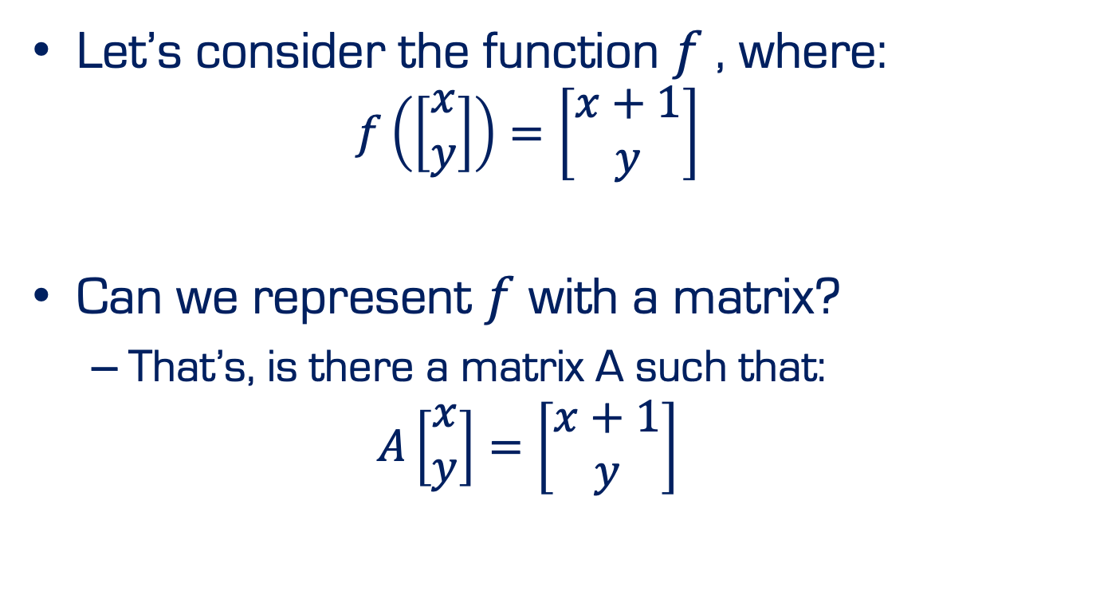
Homogeneous Coordinates
Let’s consider the function $f$, where:
$$f\left(\left[\begin{matrix}x \\ y\end{matrix}\right]\right)=\left[\begin{matrix}x+1 \\ y\end{matrix}\right]$$
Can we represent $f$ with a matrix?
That’s, is there a matrix A such that:
$$A\left[\begin{matrix}x \\ y\end{matrix}\right]=\left[\begin{matrix}x+1 \\ y\end{matrix}\right]$$

Slide 5
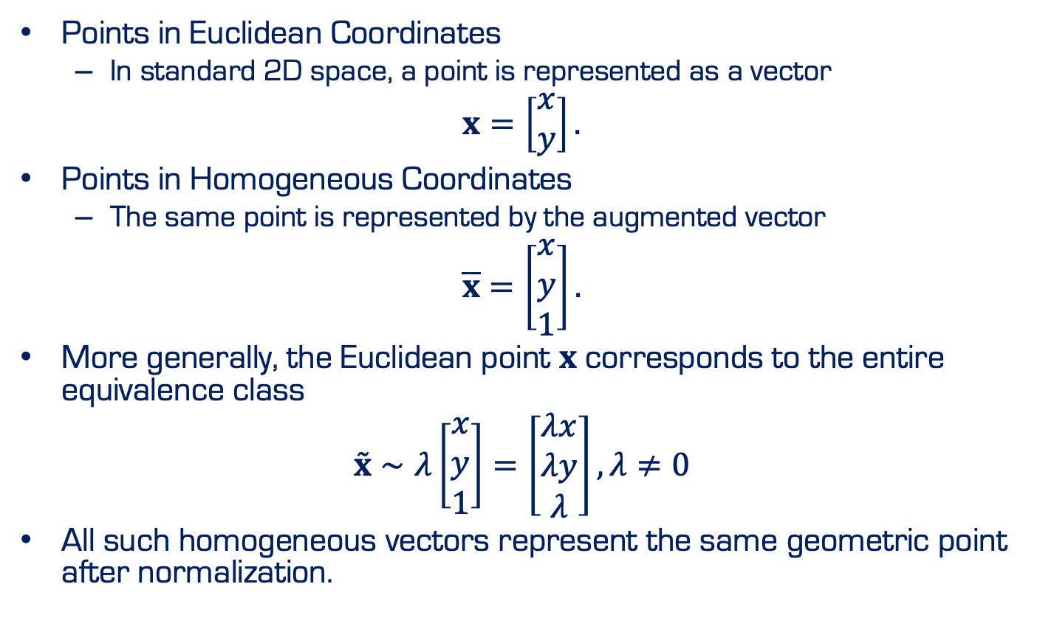
Homogeneous Coordinates
Points in Euclidean Coordinates
In standard 2D space, a point is represented as a vector
$$x=\left[\begin{matrix}x \\ y\end{matrix}\right].$$
Points in Homogeneous Coordinates
The same point is represented by the augmented vector
$$\overline{x}=\left[\begin{matrix}x \\ y \\ 1\end{matrix}\right].$$
More generally, the Euclidean point $x$ corresponds to the entire equivalence class
$$\overset{˜}{x}∼λ\left[\begin{matrix}x \\ y \\ 1\end{matrix}\right]=\left[\begin{matrix}λx \\ λy \\ λ\end{matrix}\right], λ≠0$$
All such homogeneous vectors represent the same geometric point after normalization.

Slide 6
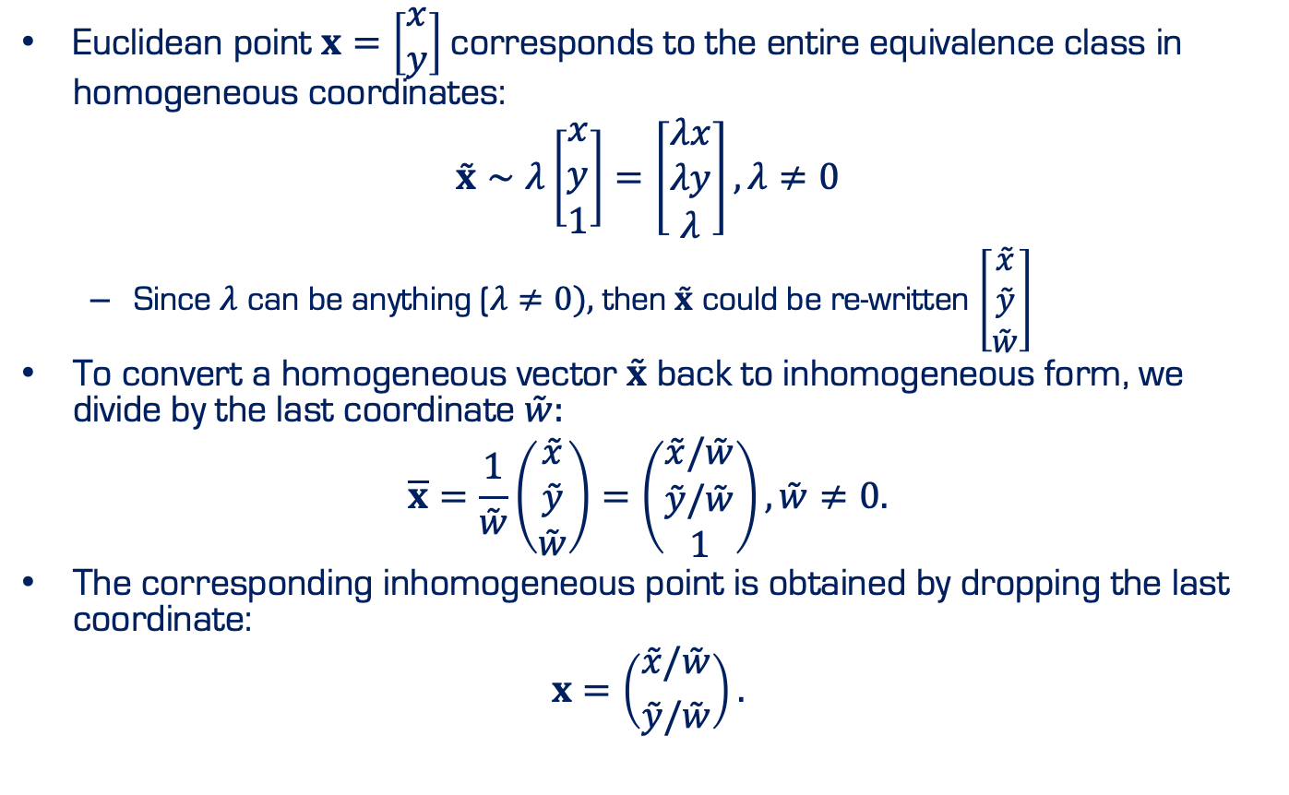
Homogeneous Coordinates
Euclidean point $x=\left[\begin{matrix}x \\ y\end{matrix}\right]$corresponds to the entire equivalence class in homogeneous coordinates:
$$\overset{˜}{x}∼λ\left[\begin{matrix}x \\ y \\ 1\end{matrix}\right]=\left[\begin{matrix}λx \\ λy \\ λ\end{matrix}\right], λ≠0$$
Since $λ$ can be anything ($λ≠0),$then $\overset{˜}{x}$ could be re-written $\left[\begin{matrix}\overset{˜}{x} \\ \overset{˜}{y} \\ \overset{˜}{w}\end{matrix}\right]$
To convert a homogeneous vector $\overset{˜}{x}$ back to inhomogeneous form, we divide by the last coordinate $\overset{˜}{w}:$
$$\overline{x}=\frac{1}{\overset{˜}{w}}\left(\begin{matrix}\overset{˜}{x} \\ \overset{˜}{y} \\ \overset{˜}{w}\end{matrix}\right)=\left(\begin{matrix}\overset{˜}{x}/\overset{˜}{w} \\ \overset{˜}{y}/\overset{˜}{w} \\ 1\end{matrix}\right), \overset{˜}{w}≠0.$$
The corresponding inhomogeneous point is obtained by dropping the last coordinate:
$$x=\left({\overset{˜}{x}/\overset{˜}{w} \atop \overset{˜}{y}/\overset{˜}{w}}\right).$$

Slide 7
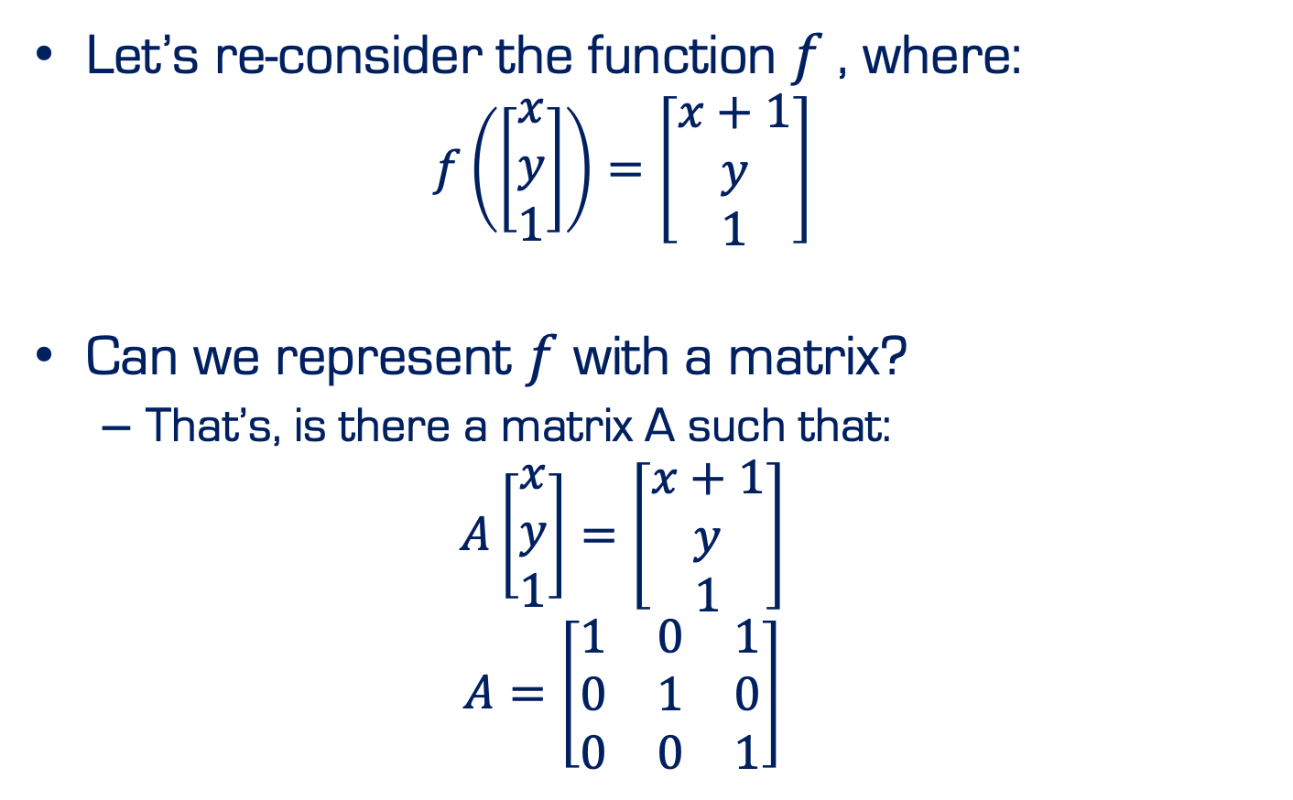
Homogeneous Coordinates
Let’s re-consider the function $f$, where:
$$f\left(\left[\begin{aligned}\begin{matrix}x \\ y\end{matrix} \\ 1\end{aligned}\right]\right)=\left[\begin{aligned}\begin{matrix}x+1 \\ y\end{matrix} \\ 1\end{aligned}\right]$$
Can we represent $f$ with a matrix?
That’s, is there a matrix A such that:
$$A\left[\begin{aligned}\begin{matrix}x \\ y\end{matrix} \\ 1\end{aligned}\right]=\left[\begin{aligned}\begin{matrix}x+1 \\ y\end{matrix} \\ 1\end{aligned}\right]$$
$$A=\left[\begin{matrix}1 & 0 & 1 \\ 0 & 1 & 0 \\ 0 & 0 & 1\end{matrix}\right]$$

Slide 8
Geometric primitive
Geometric primitives are the basic building blocks used to describe 3D shapes
Examples: Points, lines, planes

Slide 9
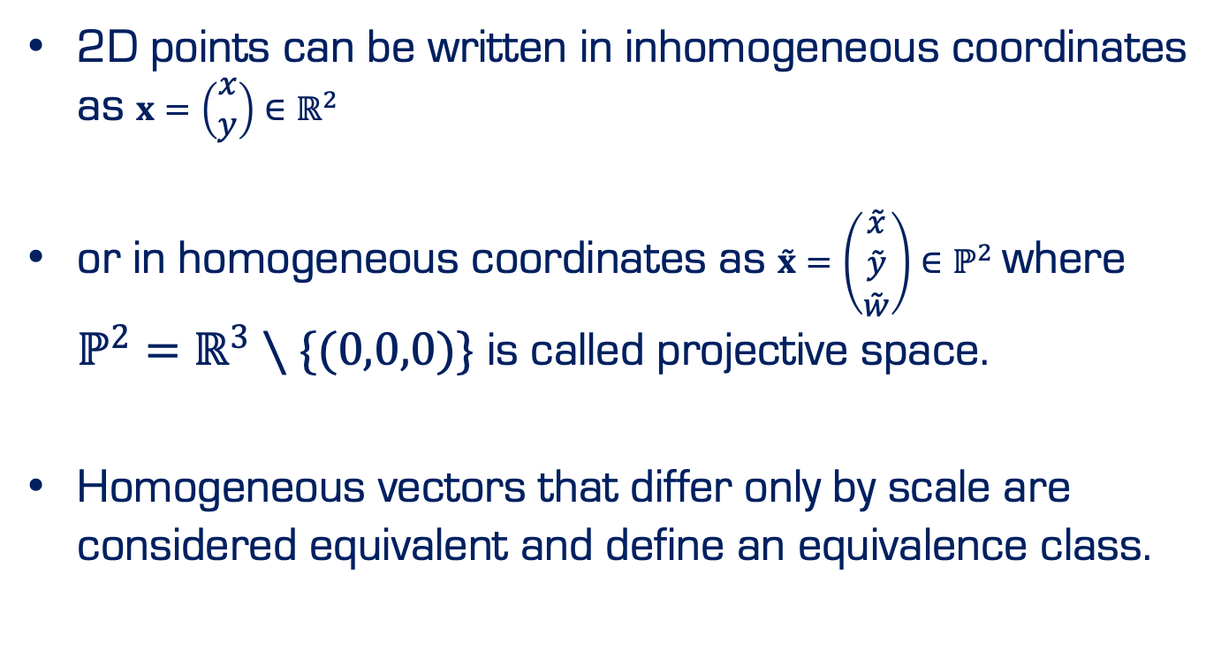
2D Points
2D points can be written in inhomogeneous coordinates as $x=\left(\begin{matrix}x \\ y\end{matrix}\right)∈ℝ^{2}$
or in homogeneous coordinates as $\overset{˜}{x}=\left(\begin{matrix}\overset{˜}{x} \\ \overset{˜}{y} \\ \overset{˜}{w}\end{matrix}\right)∈ℙ^{2}$ where $ℙ^{2}=ℝ^{3}∖\{(0,0,0)\}$ is called projective space.
Homogeneous vectors that differ only by scale are considered equivalent and define an equivalence class.

Slide 10
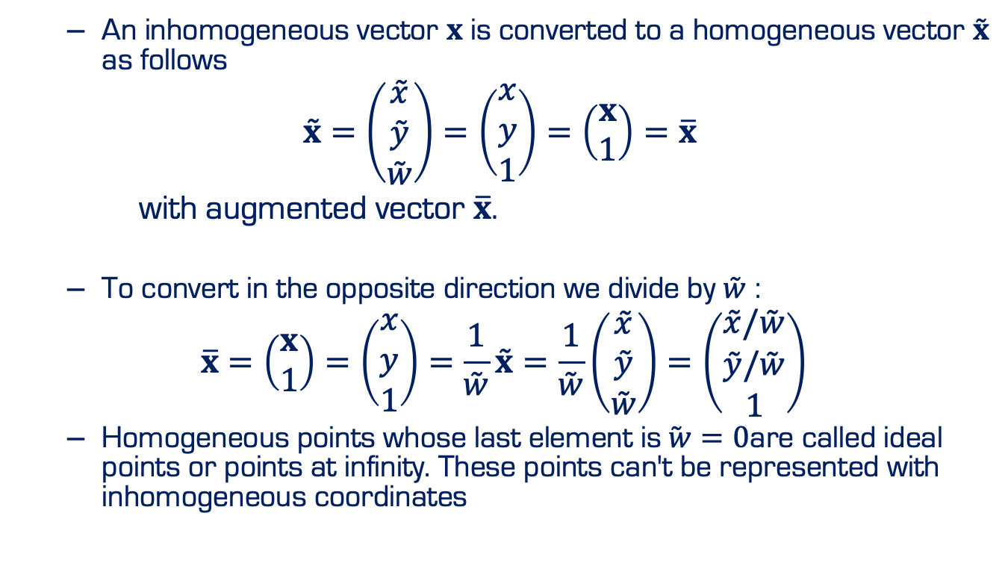
2D Points
An inhomogeneous vector $x$ is converted to a homogeneous vector $\overset{˜}{x}$ as follows
$$\overset{˜}{x}=\left(\begin{matrix}\overset{˜}{x} \\ \overset{˜}{y} \\ \overset{˜}{w}\end{matrix}\right)=\left(\begin{matrix}x \\ y \\ 1\end{matrix}\right)=\left(\begin{matrix}x \\ 1\end{matrix}\right)=\overline{x}$$
with augmented vector $\overline{x}$.
To convert in the opposite direction we divide by $\overset{˜}{w}$ :
$$\overline{x}=\left(\begin{matrix}x \\ 1\end{matrix}\right)=\left(\begin{matrix}x \\ y \\ 1\end{matrix}\right)=\frac{1}{\overset{˜}{w}}\overset{˜}{x}=\frac{1}{\overset{˜}{w}}\left(\begin{matrix}\overset{˜}{x} \\ \overset{˜}{y} \\ \overset{˜}{w}\end{matrix}\right)=\left(\begin{matrix}\overset{˜}{x}/\overset{˜}{w} \\ \overset{˜}{y}/\overset{˜}{w} \\ 1\end{matrix}\right)$$
Homogeneous points whose last element is$\overset{˜}{ w}=0$are called ideal points or points at infinity. These points can't be represented with inhomogeneous coordinates

Slide 11
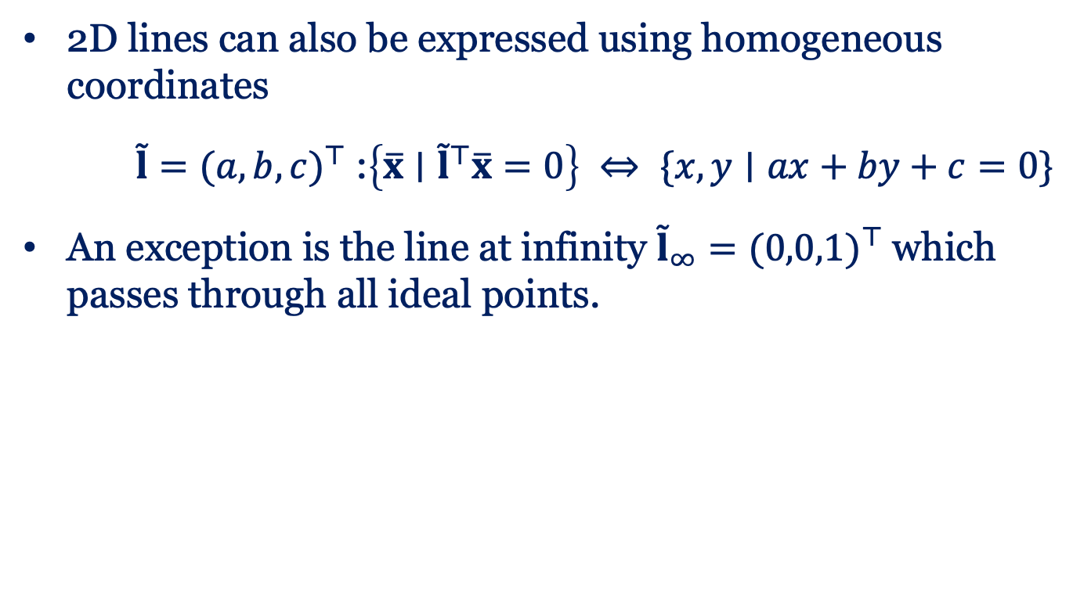
2D Lines
2D lines can also be expressed using homogeneous coordinates
$\overset{˜}{l}=(a,b,c)^{⊤}$ :$\left\{\overline{x}∣{\overset{˜}{l}}^{⊤}\overline{x}=0\right\} ⇔ \{x,y∣ax+by+c=0\}$
An exception is the line at infinity ${\overset{˜}{l}}_{∞}=(0,0,1)^{⊤}$ which passes through all ideal points.

Slide 12
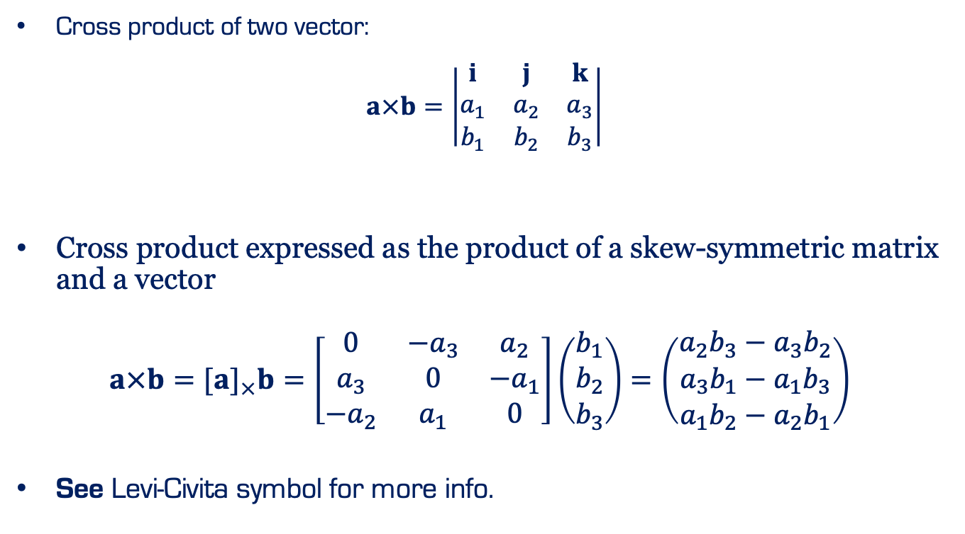
Cross Product
Cross product of two vector:
$$a×b=\left|\begin{matrix}i & j & k \\ a_{1} & a_{2} & a_{3} \\ b_{1} & b_{2} & b_{3}\end{matrix}\right|$$
Cross product expressed as the product of a skew-symmetric matrix and a vector
$a×b=[a]_{×}b=\left[\begin{matrix}0 & −a_{3} & a_{2} \\ a_{3} & 0 & −a_{1} \\ −a_{2} & a_{1} & 0\end{matrix}\right]\left(\begin{matrix}b_{1} \\ b_{2} \\ b_{3}\end{matrix}\right)=\left(\begin{matrix}a_{2}b_{3}−a_{3}b_{2} \\ a_{3}b_{1}−a_{1}b_{3} \\ a_{1}b_{2}−a_{2}b_{1}\end{matrix}\right)$
See Levi-Civita symbol for more info.

Slide 13
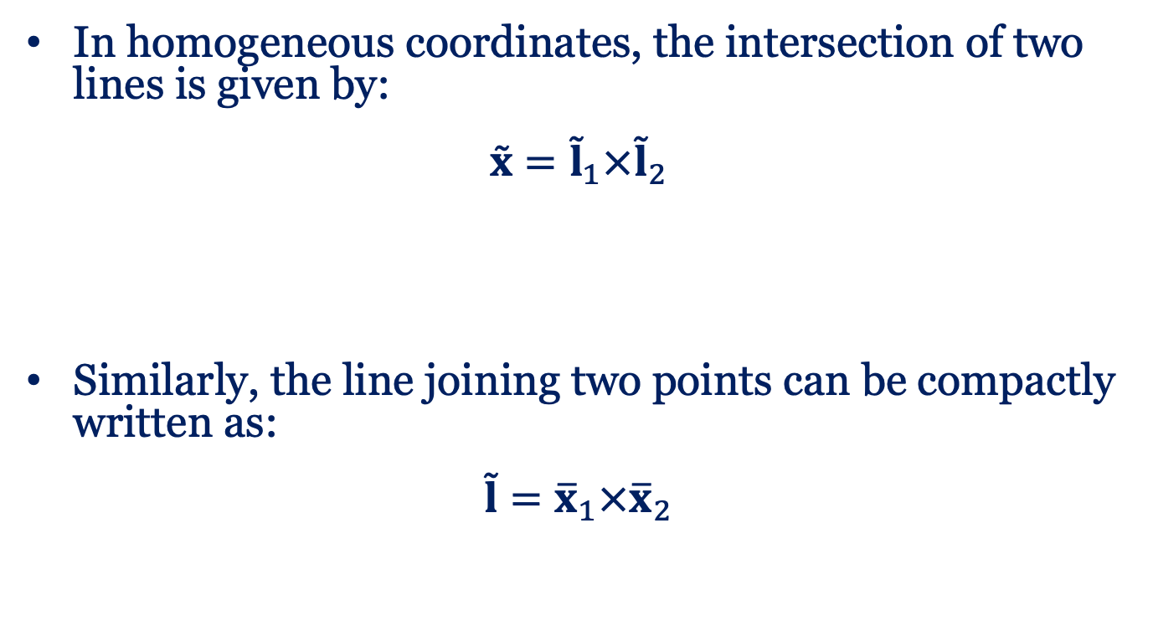
Cross Product
In homogeneous coordinates, the intersection of two lines is given by:
$$\overset{˜}{x}={\overset{˜}{l}}_{1}×{\overset{˜}{l}}_{2}$$
Similarly, the line joining two points can be compactly written as:
$$\overset{˜}{l}={\overline{x}}_{1}×{\overline{x}}_{2}$$

Slide 14
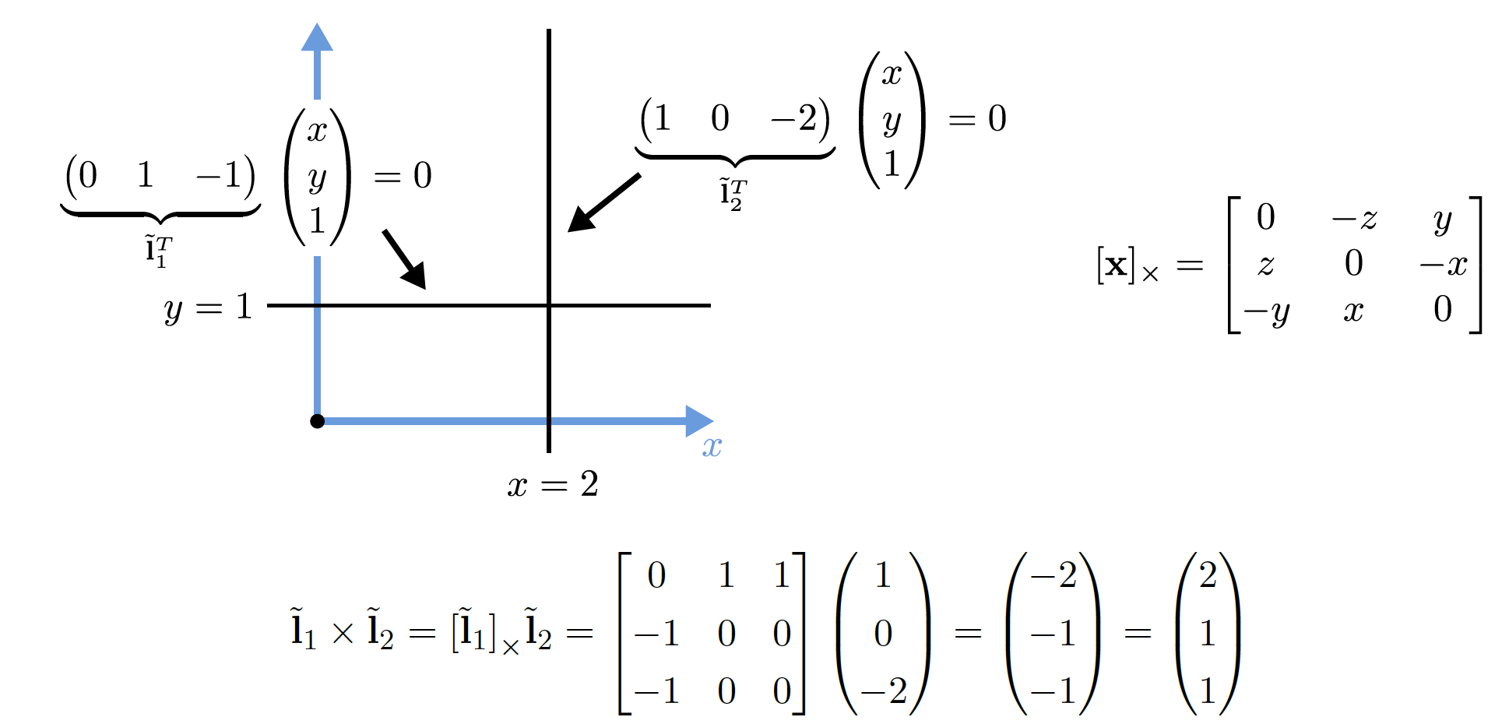
2D Line: Example

Slide 15
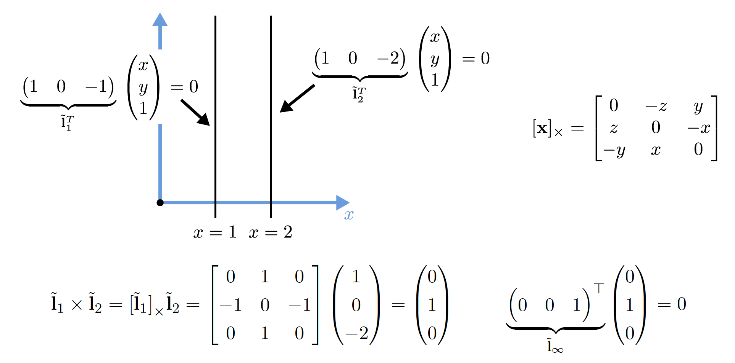
2D Line: Example

Slide 16
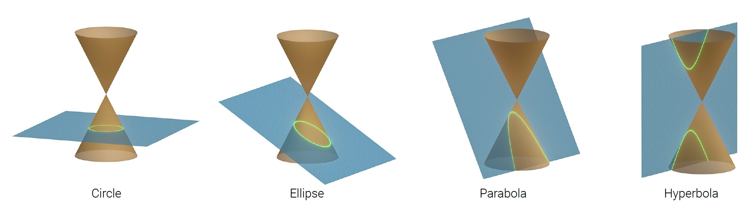
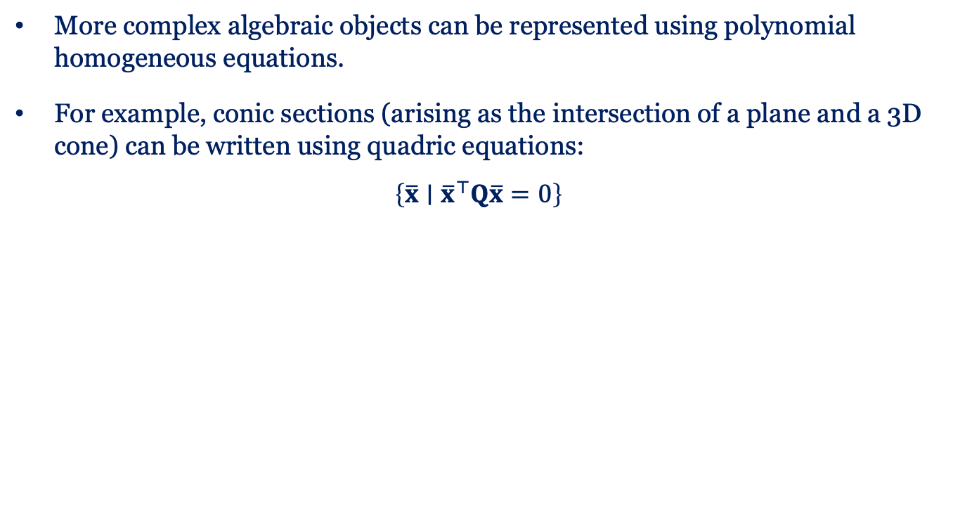
2D Conics
More complex algebraic objects can be represented using polynomial homogeneous equations.
For example, conic sections (arising as the intersection of a plane and a 3D cone) can be written using quadric equations:
$$\left\{\overline{x}∣{\overline{x}}^{⊤}Q\overline{x}=0\right\}$$

Slide 17
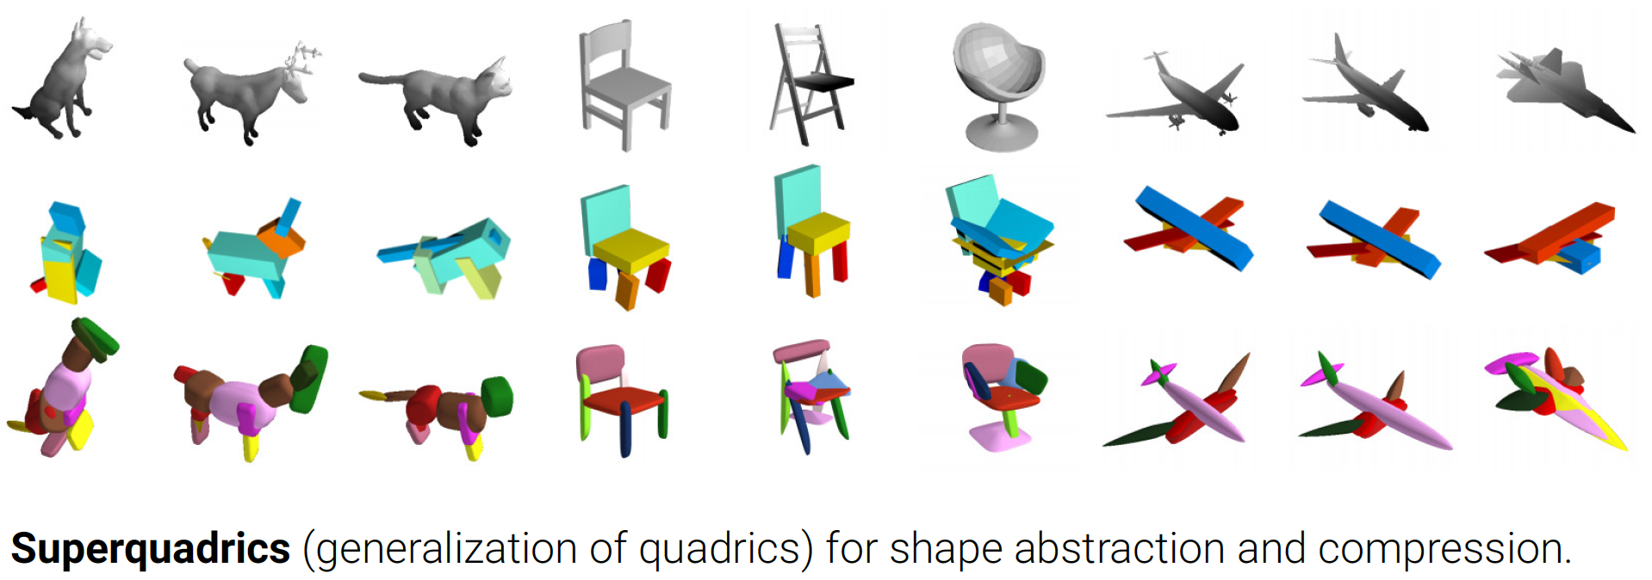

3D Quadrics
The 3D analog of 2D conics is a quadric surface:
$$\left\{\overline{x}∣{\overline{x}}^{⊤}Q\overline{x}=0\right\}$$
Paschalidou, Ulusoy and Geiger: Superquadrics Revisited: Learning 3D Shape Parsing beyond Cuboids. CVPR, 2019

Slide 18
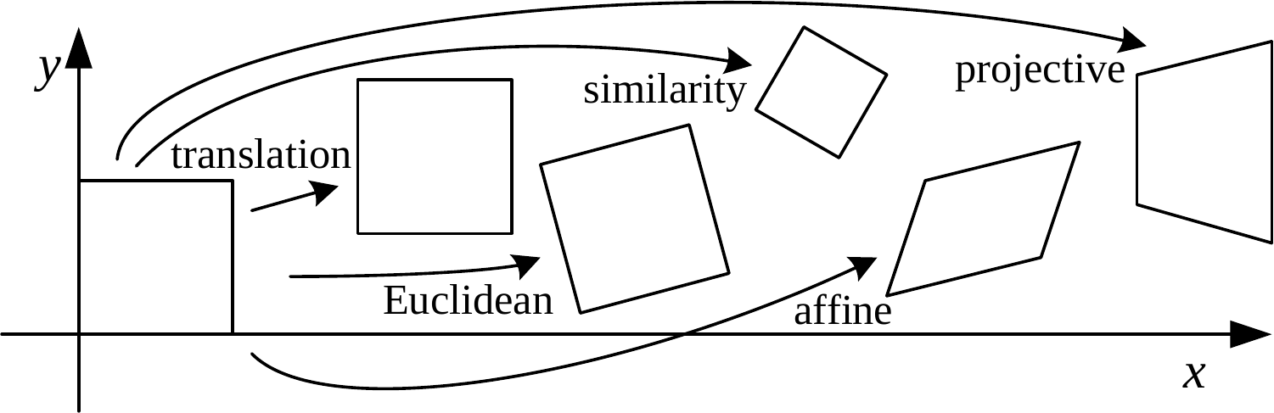
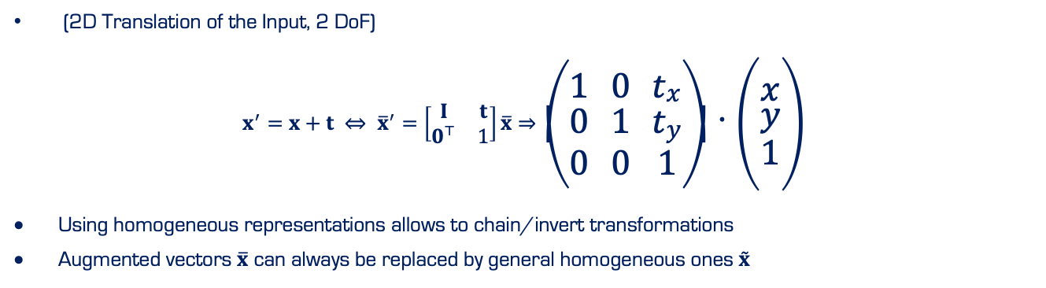
Translation
(2D Translation of the Input, 2 DoF)
$$x^{′}=x+t ⇔ {\overline{x}}^{′}=\left[\begin{matrix}I & t \\ 0^{⊤} & 1\end{matrix}\right]\overline{x}⇒\left(\begin{matrix}1 & 0 & t_{x} \\ 0 & 1 & t_{y} \\ 0 & 0 & 1\end{matrix}\right)⋅\left(\begin{matrix}x \\ y \\ 1\end{matrix}\right)$$
Using homogeneous representations allows to chain/invert transformations
Augmented vectors $\overline{x}$ can always be replaced by general homogeneous ones $\overset{˜}{x}$

Slide 19
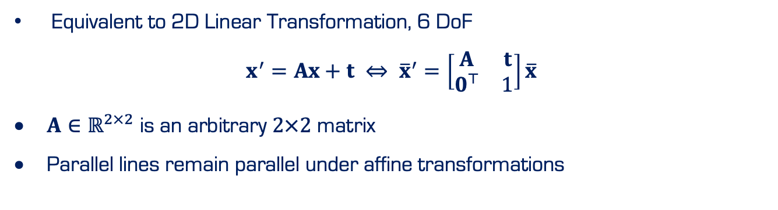
Affine
Equivalent to 2D Linear Transformation, 6 DoF
$$x^{′}=Ax+t ⇔ {\overline{x}}^{′}=\left[\begin{matrix}A & t \\ 0^{⊤} & 1\end{matrix}\right]\overline{x}$$
$A∈ℝ^{2×2}$ is an arbitrary $2×2$ matrix
Parallel lines remain parallel under affine transformations

Slide 20
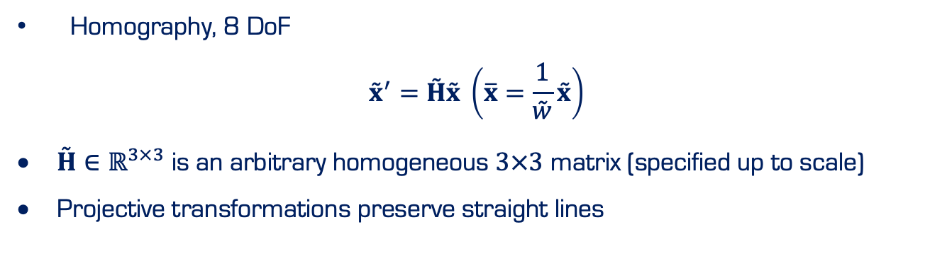
Projective
Homography, 8 DoF
$${\overset{˜}{x}}^{′}=\overset{˜}{H}\overset{˜}{x} \left(\overline{x}=\frac{1}{\overset{˜}{w}}\overset{˜}{x}\right)$$
$\overset{˜}{H}∈ℝ^{3×3}$ is an arbitrary homogeneous $3×3$ matrix (specified up to scale)
Projective transformations preserve straight lines
Notes:
Sia

Slide 21
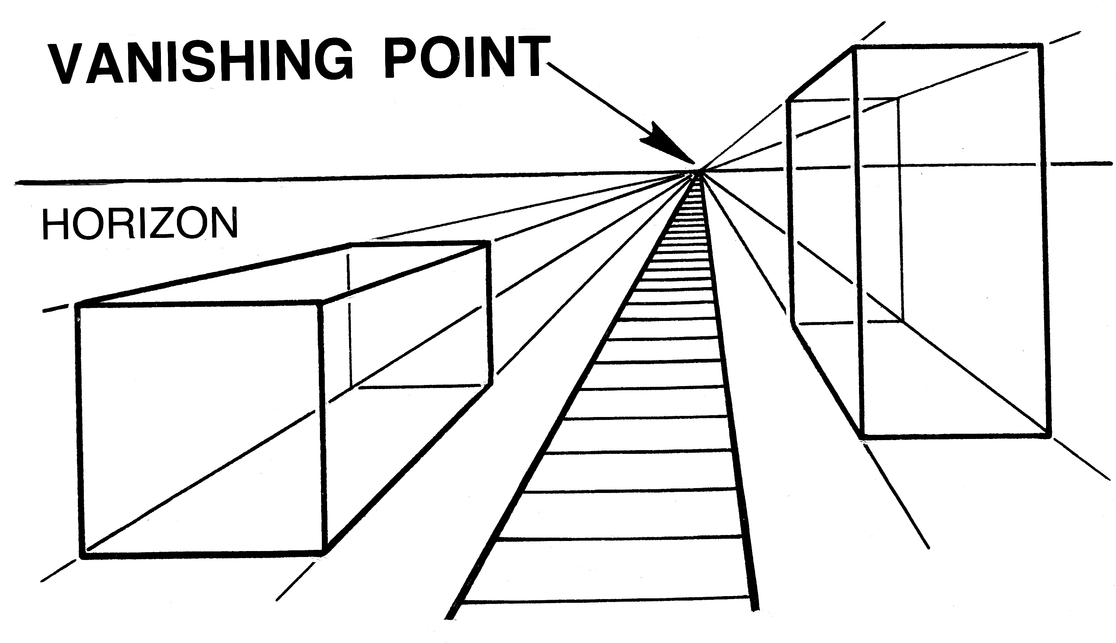
Projective
©commons.wikimedia.org
Notes:
Sia

Slide 22
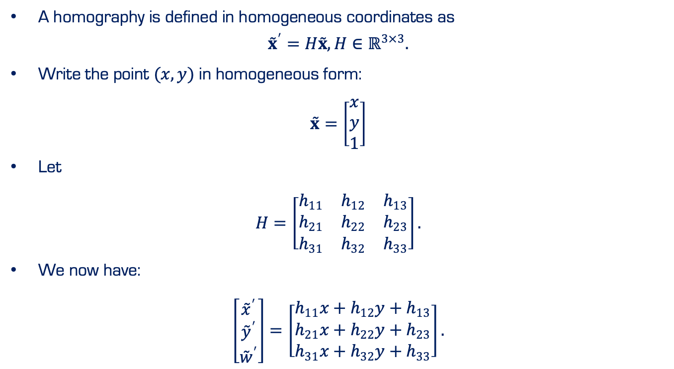
Projective
A homography is defined in homogeneous coordinates as
$${\overset{˜}{x}}^{′}=H\overset{˜}{x}, H∈ℝ^{3×3}.$$
Write the point $(x,y)$ in homogeneous form:
$$\overset{˜}{x}=\left[\begin{matrix}x \\ y \\ 1\end{matrix}\right]$$
Let
$$H=\left[\begin{matrix}h_{11} & h_{12} & h_{13} \\ h_{21} & h_{22} & h_{23} \\ h_{31} & h_{32} & h_{33}\end{matrix}\right].$$
We now have:
$$\left[\begin{matrix}{\overset{˜}{x}}^{′} \\ {\overset{˜}{y}}^{′} \\ {\overset{˜}{w}}^{′}\end{matrix}\right]=\left[\begin{matrix}h_{11}x+h_{12}y+h_{13} \\ h_{21}x+h_{22}y+h_{23} \\ h_{31}x+h_{32}y+h_{33}\end{matrix}\right].$$
Notes:
Sia

Slide 23
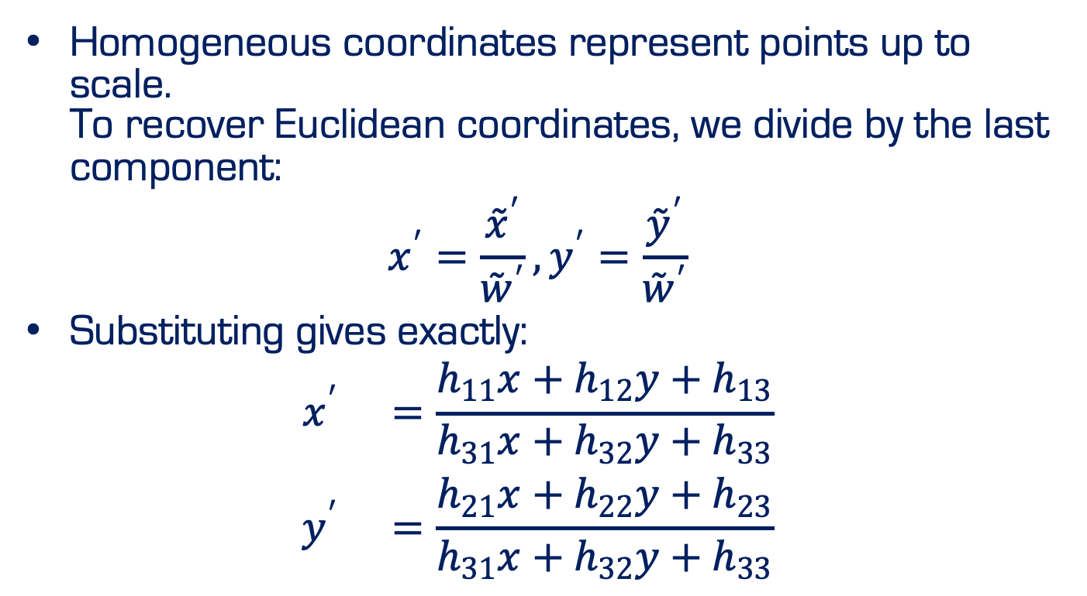
Projective
Homogeneous coordinates represent points up to scale. To recover Euclidean coordinates, we divide by the last component:
$$x^{′}=\frac{{\overset{˜}{x}}^{′}}{{\overset{˜}{w}}^{′}}, y^{′}=\frac{{\overset{˜}{y}}^{′}}{{\overset{˜}{w}}^{′}}$$
Substituting gives exactly:
$$\begin{matrix}x^{′} & =\frac{h_{11}x+h_{12}y+h_{13}}{h_{31}x+h_{32}y+h_{33}} \\ y^{′} & =\frac{h_{21}x+h_{22}y+h_{23}}{h_{31}x+h_{32}y+h_{33}}\end{matrix}$$
Notes:
Sia

Slide 24
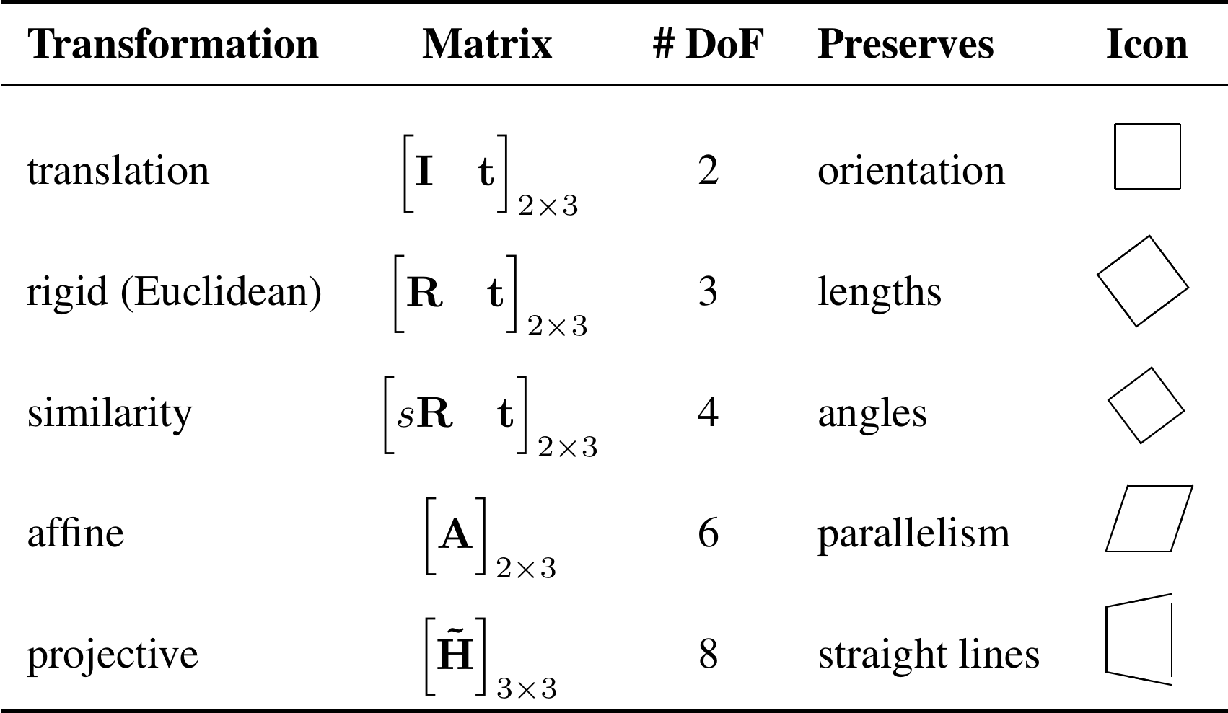
2D Transformation

Slide 25
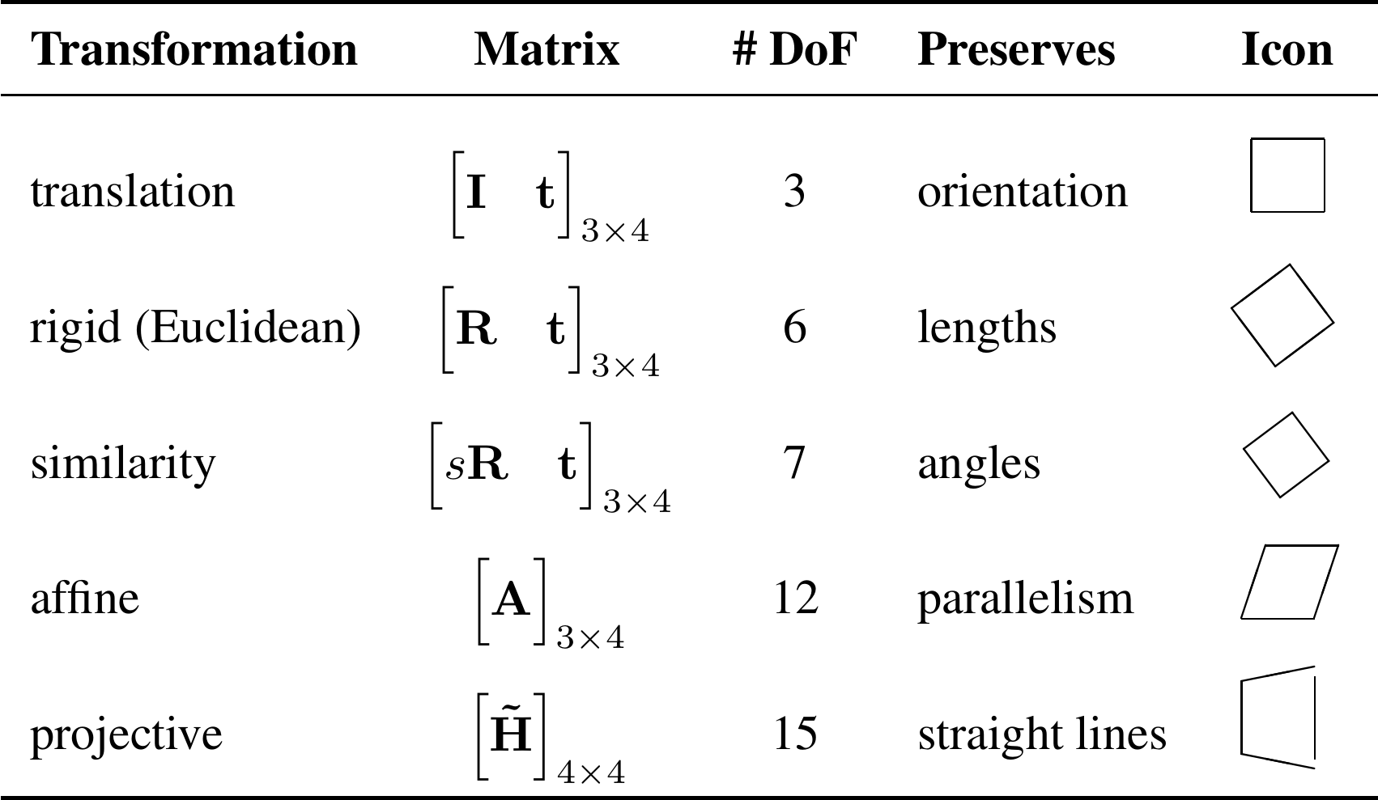
3D Transformation

Slide 26

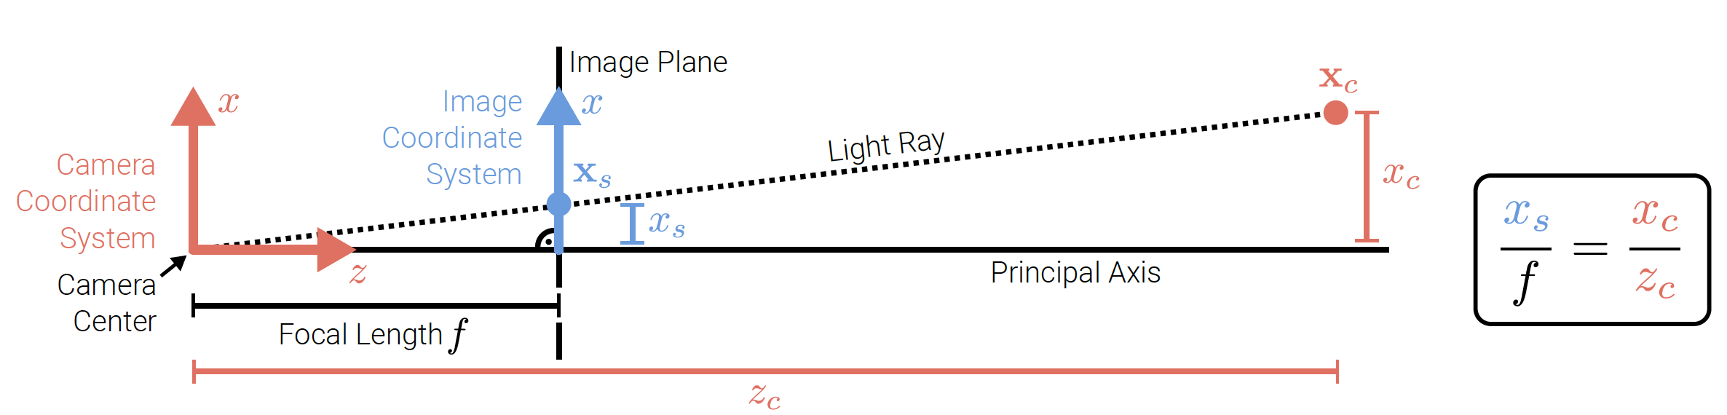
Geometric Image Formation

Slide 27
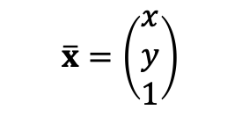
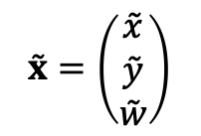
2D Points
Homogeneous Vector
$$\overset{˜}{x}=\left(\begin{matrix}\overset{˜}{x} \\ \overset{˜}{y} \\ \overset{˜}{w}\end{matrix}\right)$$
$$\overline{x}=\left(\begin{matrix}x \\ y \\ 1\end{matrix}\right)$$
Augmented Vector
Homogeneous Coordinates
Inhomogeneous Coordinates

Slide 28
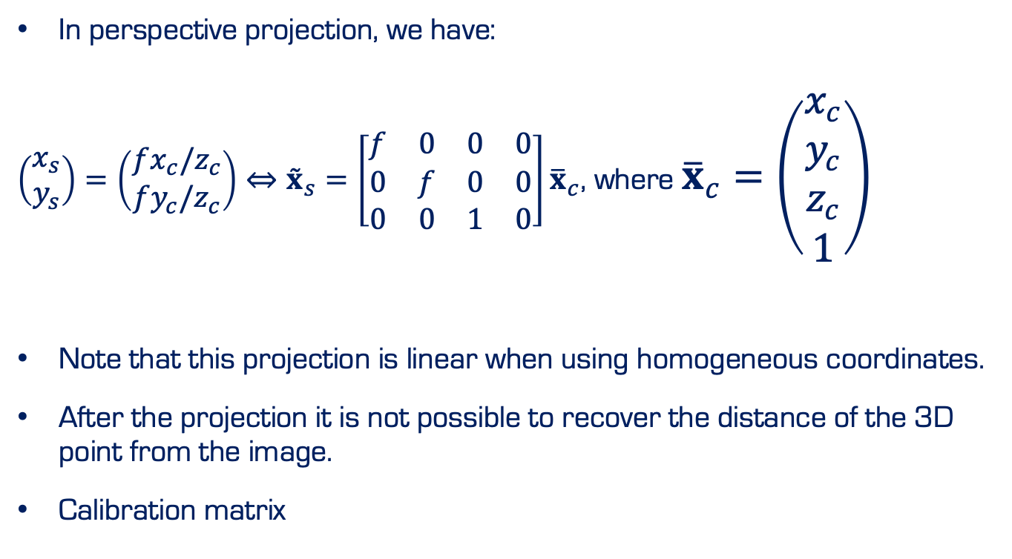
Perspective Projection
In perspective projection, we have:
$\left(\begin{matrix}x_{s} \\ y_{s}\end{matrix}\right)=\left(\begin{matrix}fx_{c}/z_{c} \\ fy_{c}/z_{c}\end{matrix}\right)⇔{\overset{˜}{x}}_{s}=\left[\begin{matrix}f & 0 & 0 & 0 \\ 0 & f & 0 & 0 \\ 0 & 0 & 1 & 0\end{matrix}\right]{\overline{x}}_{c}$, where ${\overline{x}}_{c}=\left(\begin{matrix}x_{c} \\ y_{c} \\ z_{c} \\ 1\end{matrix}\right)$
Note that this projection is linear when using homogeneous coordinates.
After the projection it is not possible to recover the distance of the 3D point from the image.
Calibration matrix

Slide 29
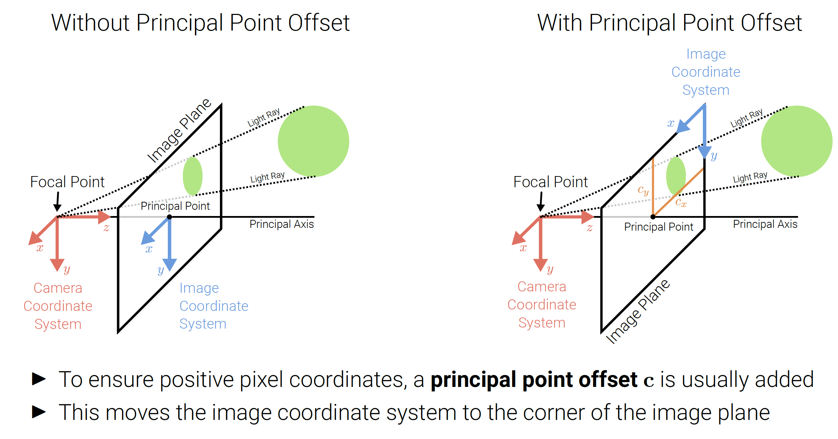
Perspective Projection

Slide 30
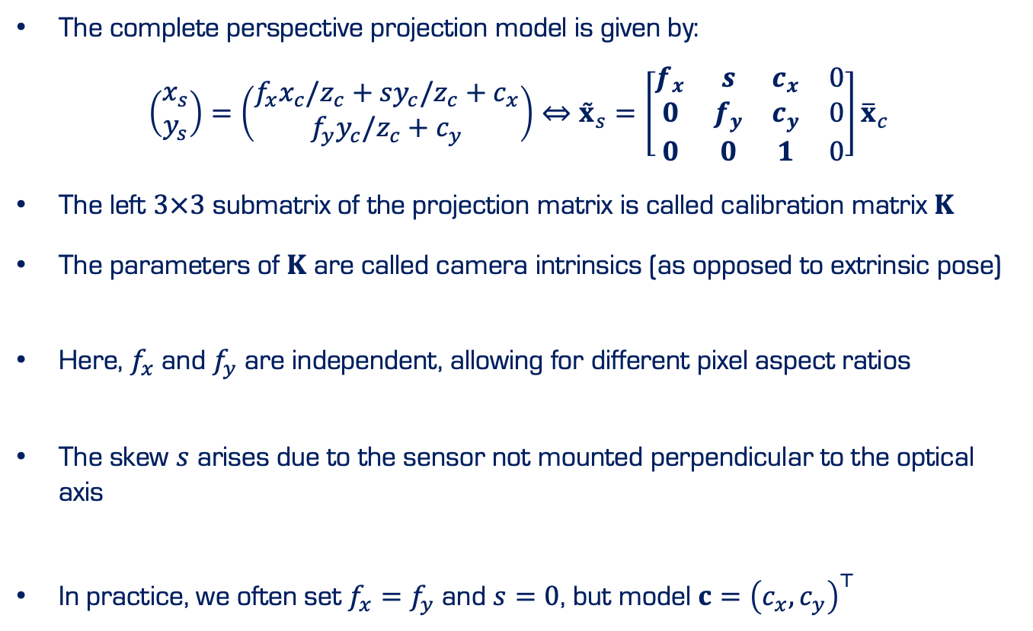
Perspective Projection
The complete perspective projection model is given by:
$$\left(\begin{matrix}x_{s} \\ y_{s}\end{matrix}\right)=\left(\begin{matrix}f_{x}x_{c}/z_{c}+sy_{c}/z_{c}+c_{x} \\ f_{y}y_{c}/z_{c}+c_{y}\end{matrix}\right)⇔{\overset{˜}{x}}_{s}=\left[\begin{matrix}f_{x} & s & c_{x} & 0 \\ 0 & f_{y} & c_{y} & 0 \\ 0 & 0 & 1 & 0\end{matrix}\right]{\overline{x}}_{c}$$
The left $3×3$ submatrix of the projection matrix is called calibration matrix $K$
The parameters of $K$ are called camera intrinsics (as opposed to extrinsic pose)
Here, $f_{x}$ and $f_{y}$ are independent, allowing for different pixel aspect ratios
The skew $s$ arises due to the sensor not mounted perpendicular to the optical axis
In practice, we often set $f_{x}=f_{y}$ and $s=0$, but model $c={\left(c_{x},c_{y}\right)}^{⊤}$

Slide 31
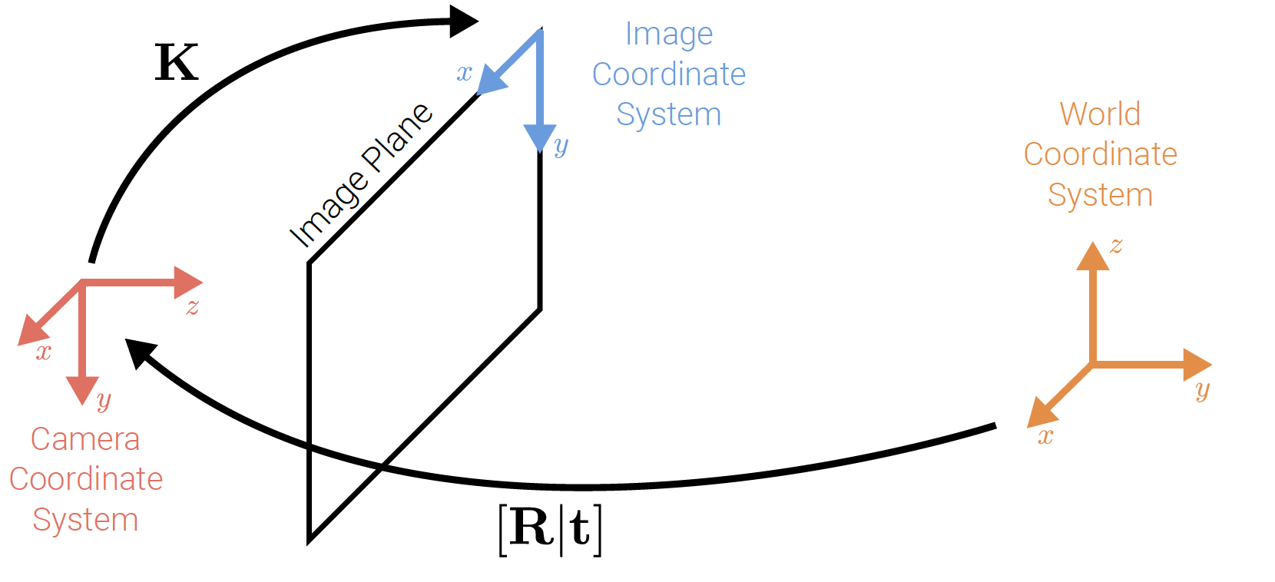
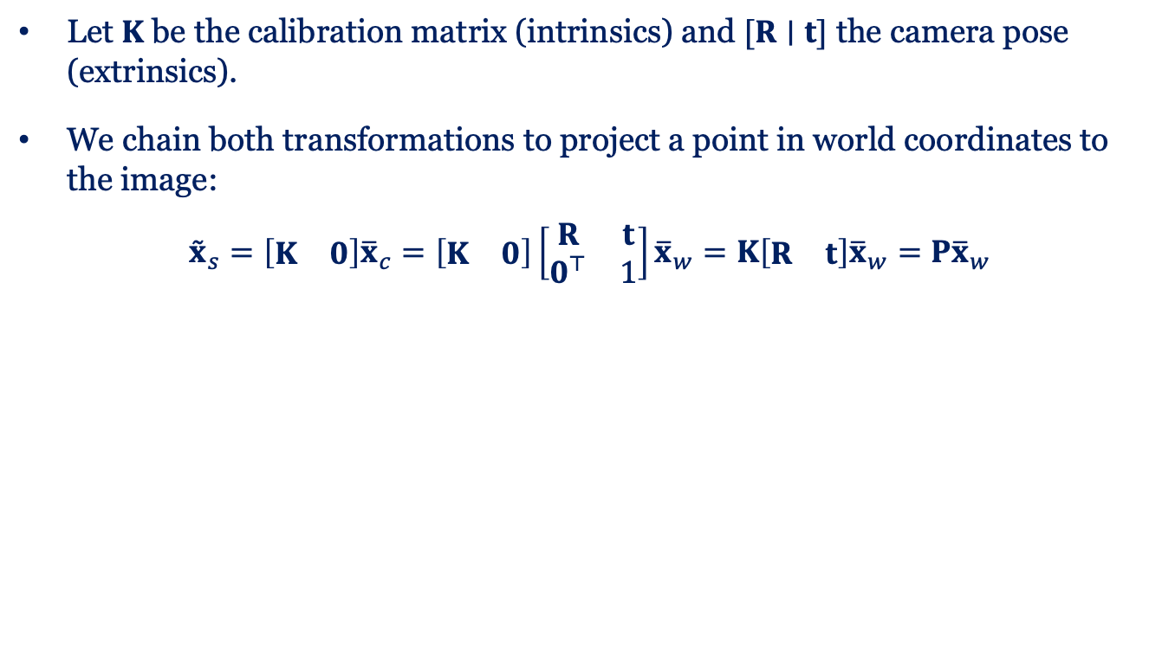
Chaining Transformation
Let $K$ be the calibration matrix (intrinsics) and $[R∣t]$ the camera pose (extrinsics).
We chain both transformations to project a point in world coordinates to the image:
$${\overset{˜}{x}}_{s}=\left[\begin{matrix}K & 0\end{matrix}\right]{\overline{x}}_{c}=\left[\begin{matrix}K & 0\end{matrix}\right]\left[\begin{matrix}R & t \\ 0^{⊤} & 1\end{matrix}\right]{\overline{x}}_{w}=K\left[\begin{matrix}R & t\end{matrix}\right]{\overline{x}}_{w}=P{\overline{x}}_{w}$$

Slide 32
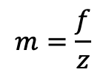

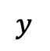
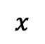
Perspective Projection
$$m=\frac{f}{z}$$
Image Magnification:
Image size inversely proportional to depth
f: Effective focal length
z
$$y$$
$$z$$
$$x$$

Slide 33
Perspective Projection
Vanishing point
$$y$$
$$z$$
$$x$$

Slide 34
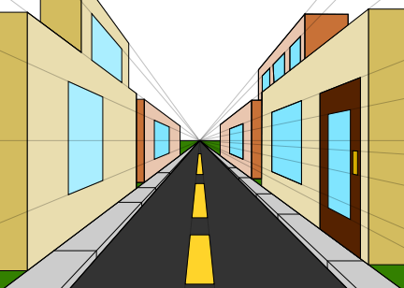

Perspective Projection
Vanishing point:
$$\left(x_{vp},y_{vp}\right)=\left(f\frac{l_{x}}{l_{z}},f\frac{l_{y}}{l_{z}}\right)$$
https://commons.wikimedia.org/wiki/File:1_point_perspective.svg

Slide 35
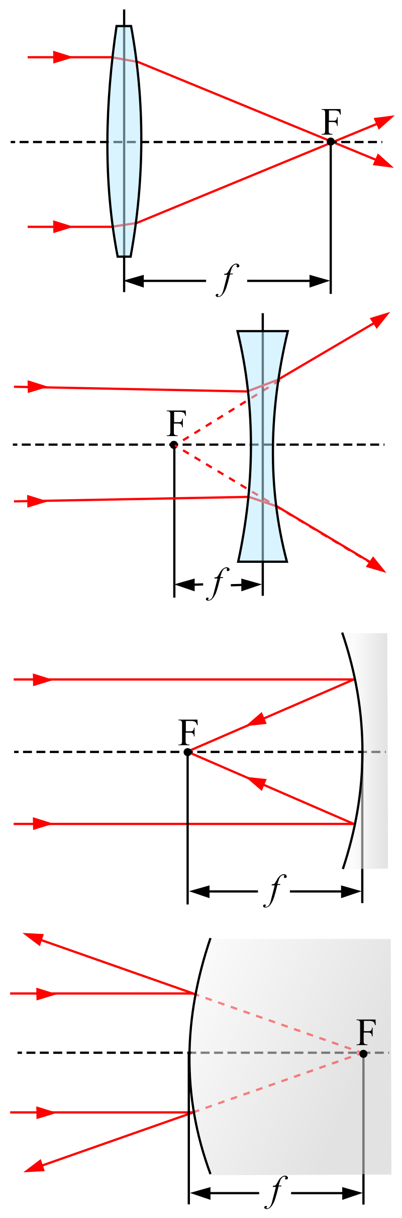
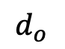
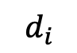
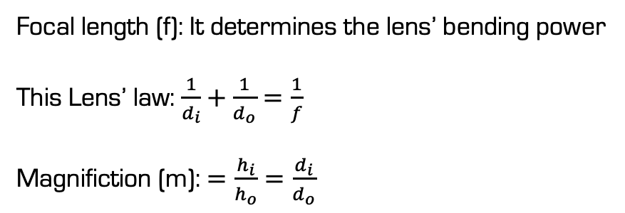
Lens
$$d_{o}$$
f
$$d_{i}$$
Focal length (f): It determines the lens’ bending power
This Lens’ law: $\frac{1}{d_{i}}+\frac{1}{d_{o}}=\frac{1}{f}$
Magnifiction (m): $=\frac{h_{i}}{h_{o}}=\frac{d_{i}}{d_{o}}$
https://en.wikipedia.org/wiki/Focal_length

Slide 36
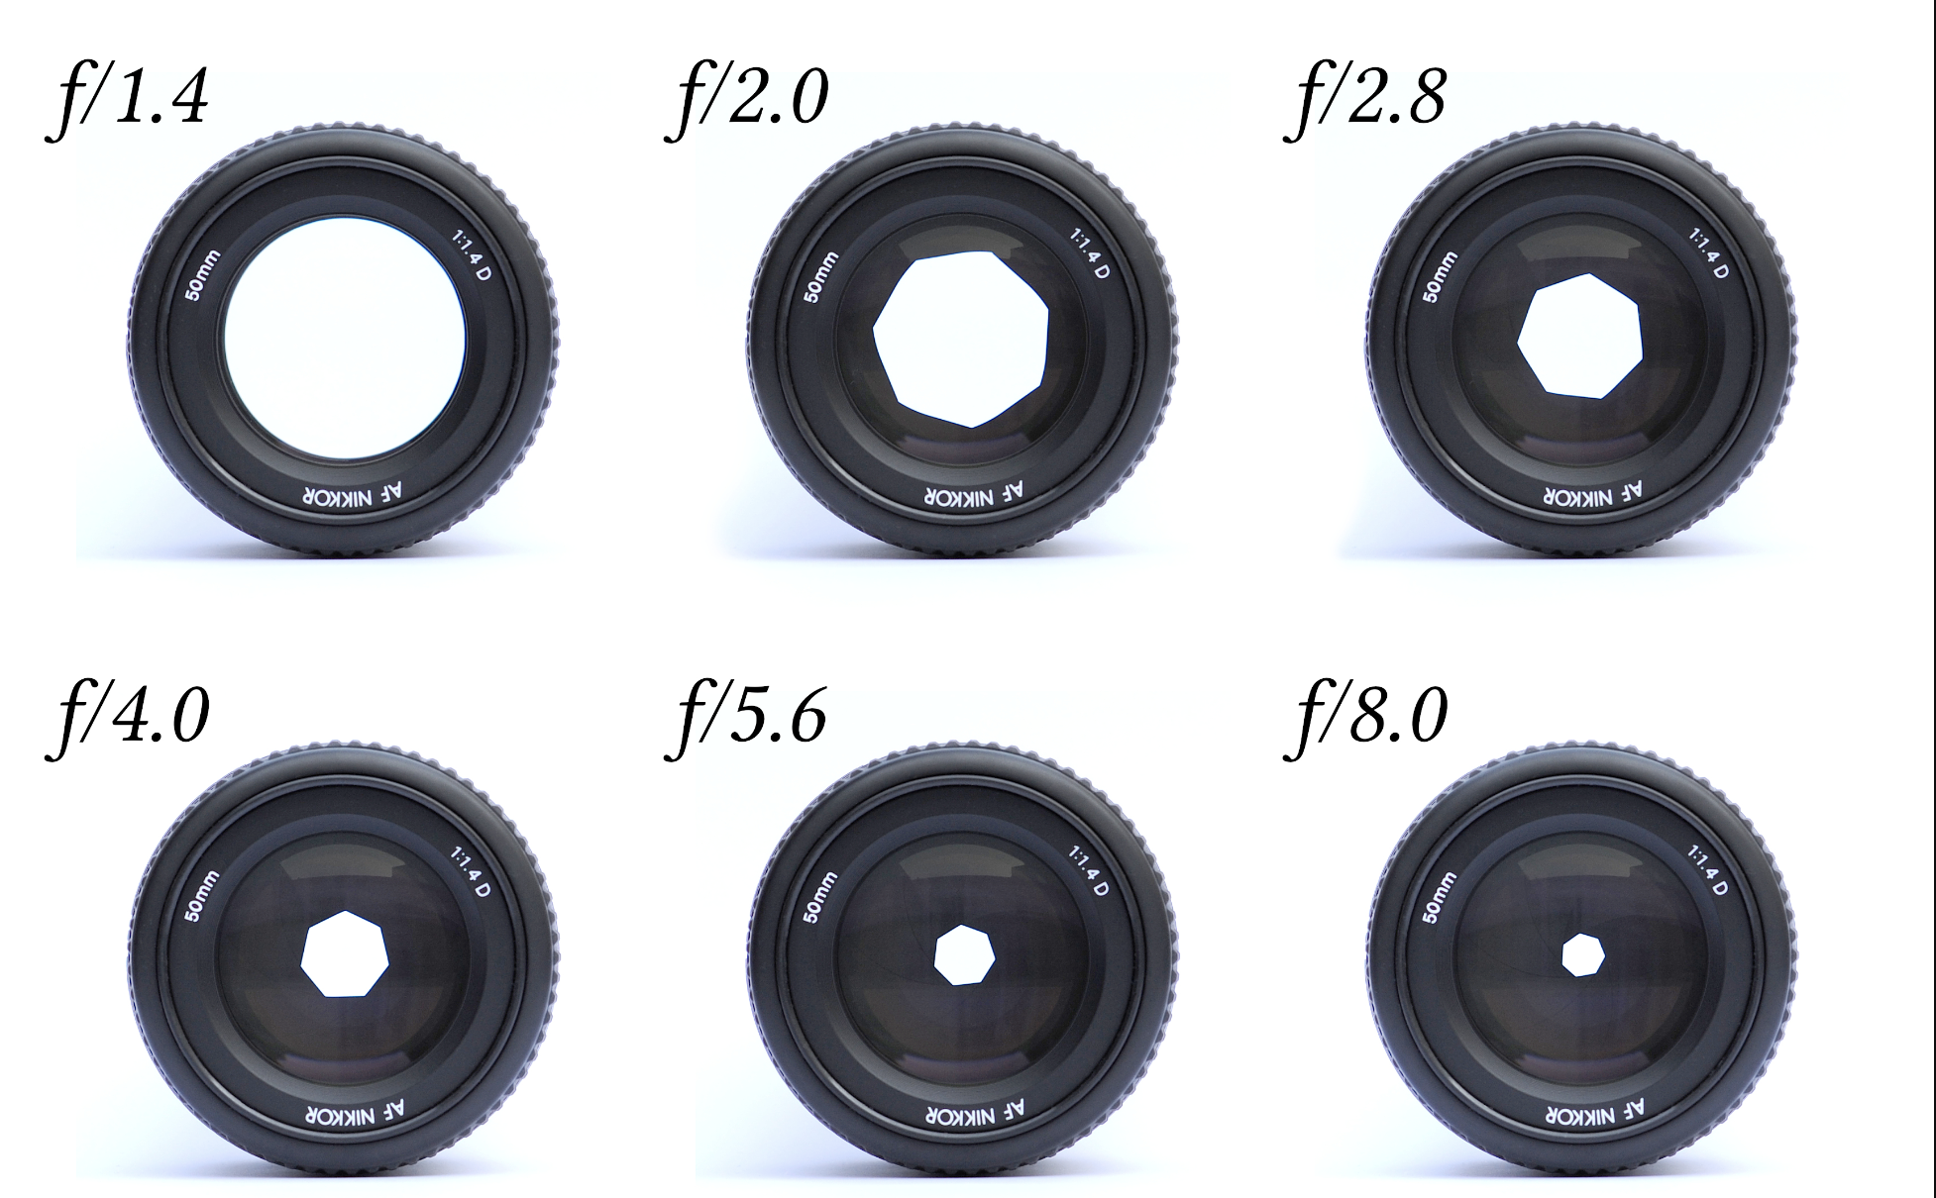
Lens
Aperture: Area of the lens receiving light

Slide 37
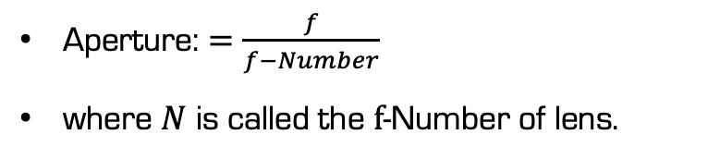
Lens
Aperture: Area of the lens receiving light
f-number: a measure of the light-gathering ability of a camera lens
it equals focal length divided by the aperture.
Aperture: $=\frac{f}{f−Number}$
where $N$ is called the $f$-Number of lens.

Slide 38
Lens Defocus
Aperture
Image Plane
How to find the blur circle

Slide 39
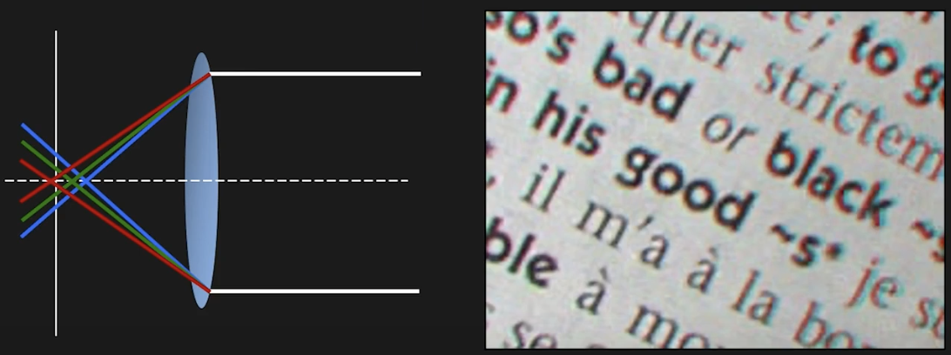
Lens Distortion
Chromatic Aberration
Refractive index (and hence focal length) of lens is different for different wavelengths.

Slide 40
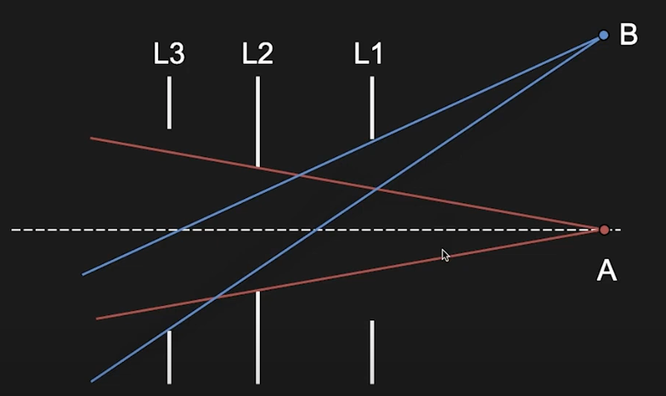

Lens Distortion
Vignetting

Slide 41
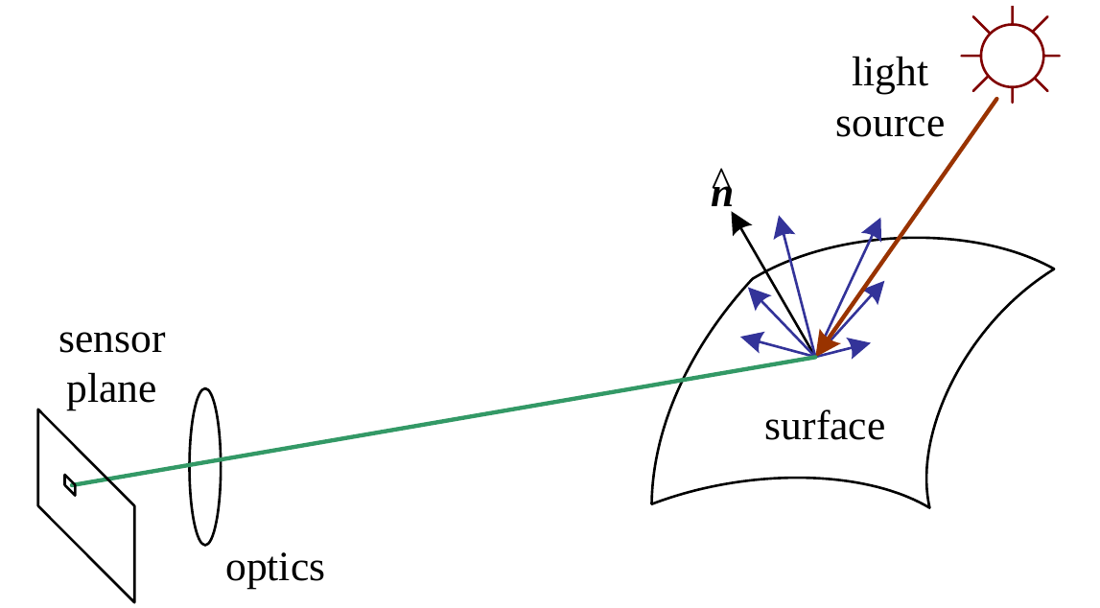
Photometric Image Formation
How an image is formed in terms of pixel intensities and colors.
Light is emitted by one or more light sources and reflected or refracted (once or multiple times) at surfaces of objects (or media) in the scene

Slide 42
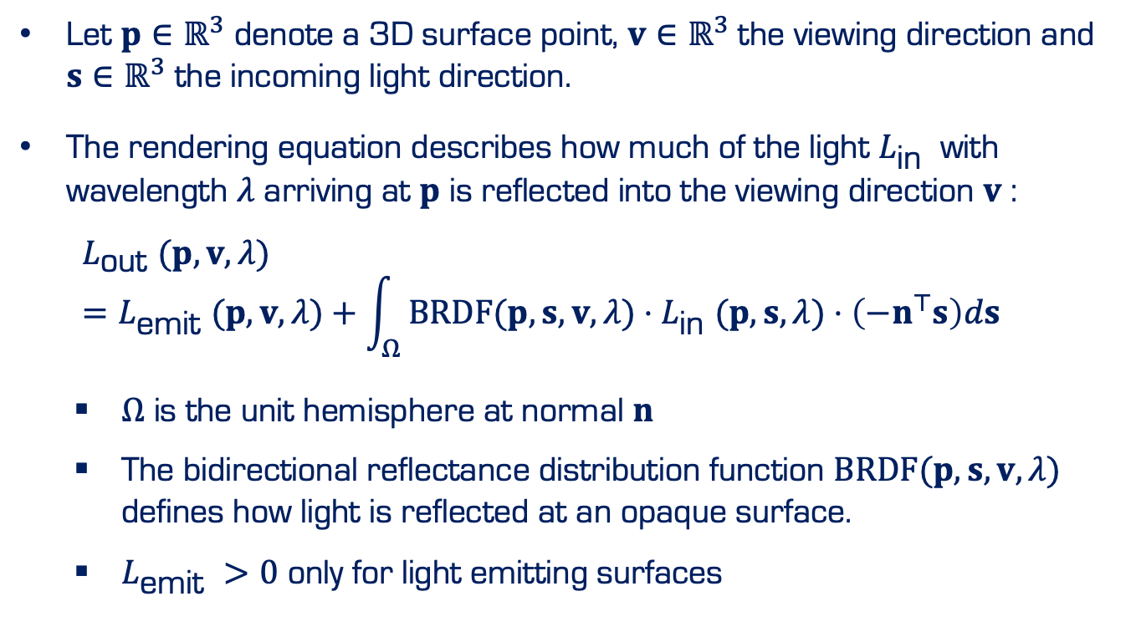
Rendering Equation
Let $p∈ℝ^{3}$ denote a 3D surface point, $v∈ℝ^{3}$ the viewing direction and $s∈ℝ^{3}$ the incoming light direction.
The rendering equation describes how much of the light $L_{\text{in} }$ with wavelength $λ$ arriving at $p$ is reflected into the viewing direction $v$ :
$$L_{\text{out} }(p,v,λ)=L_{\text{emit} }(p,v,λ)+\int_{Ω}{ }BRDF⁡(p,s,v,λ)⋅L_{\text{in} }(p,s,λ)⋅\left(−n^{⊤}s\right)ds$$
$Ω$ is the unit hemisphere at normal $n$
The bidirectional reflectance distribution function $BRDF⁡(p,s,v,λ)$ defines how light is reflected at an opaque surface.
$L_{\text{emit} }>0$ only for light emitting surfaces

Slide 43
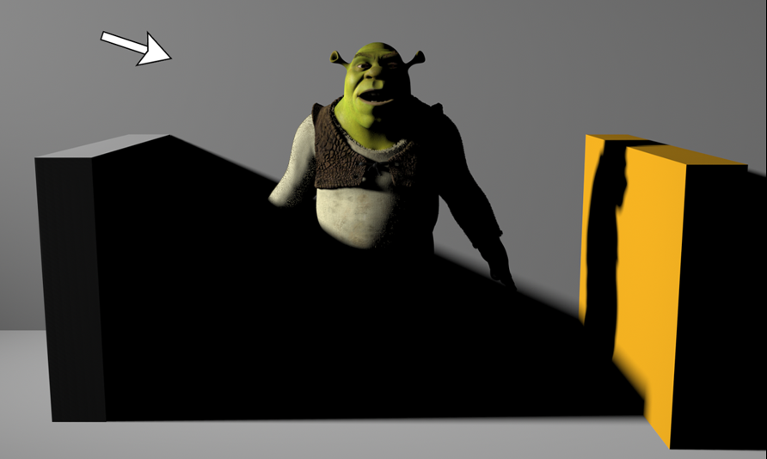
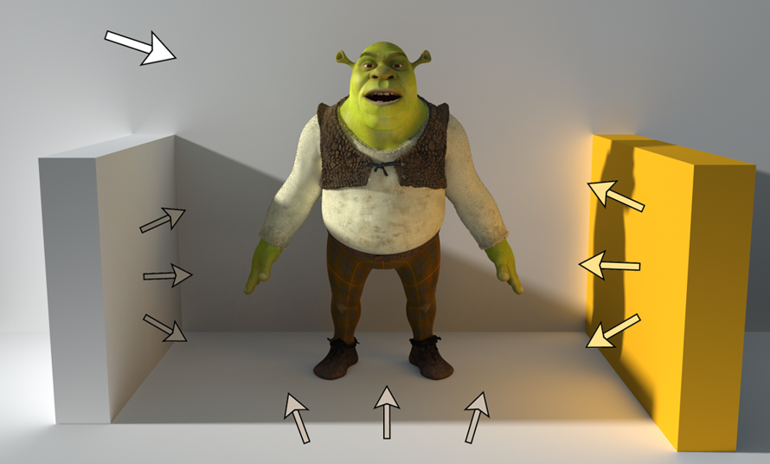
Global Illumination
Modeling one light bounce is insufficient for rendering complex scenes
I Light sources can be shadowed by occluders and rays can bounce multiple times
I Global illumination techniques also take indirect illumination into account

Slide 44
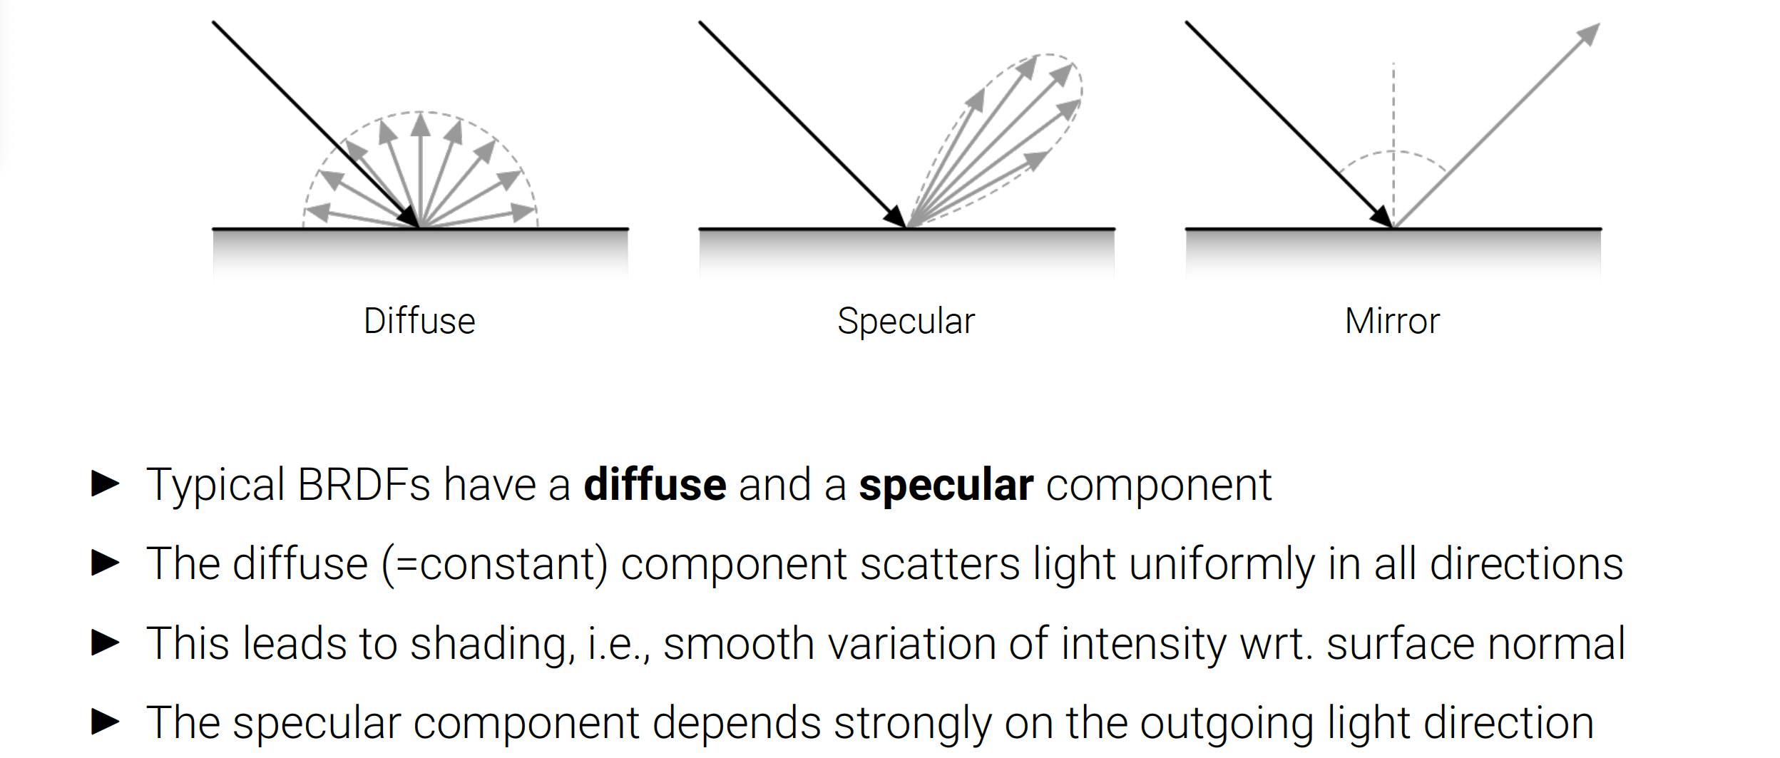
Diffuse and Specular Reflection

Slide 45
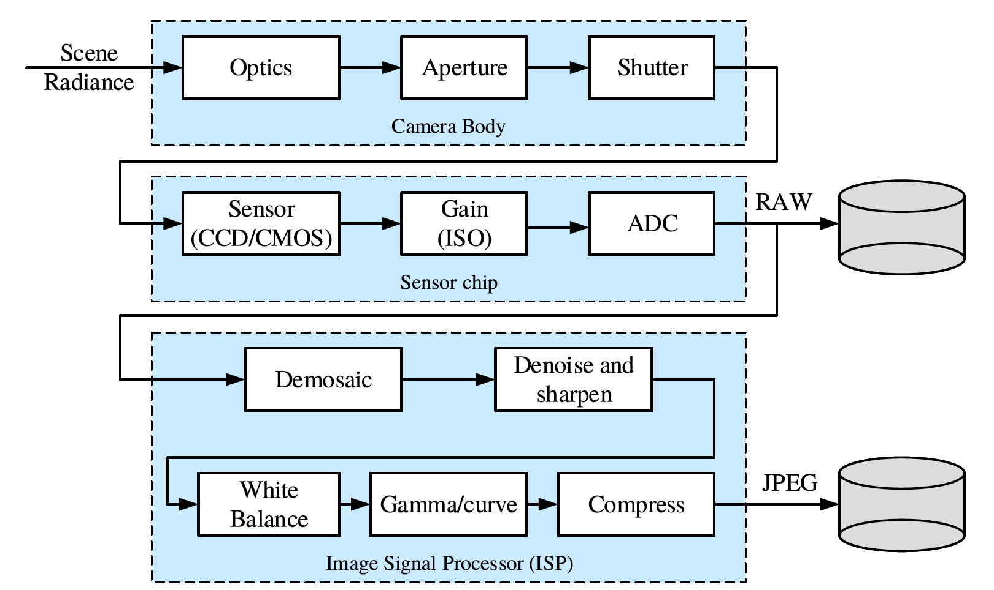
Image Sensor
Physical light transport in the camera lens/body
Photon measurement and conversion on the sensor chip
Image signal processing (ISP) and image compression

Slide 46

Image Sensor
I CCDs move charge from pixel to pixel and convert it to voltage at the output node
I CMOS images convert charge to voltage inside each pixel and are standard
https://meroli.web.cern.ch/lecture_cmos_vs_ccd_pixel_sensor.html

Slide 47


Image Sensor
Color Filter:
To measure color, pixels are arranged in a color array, e.g.: Bayer RGB pattern
I Missing colors at each pixel are interpolated from the neighbors (demosaicing)

Slide 48



Image Sensor
Color Filter:
To measure color, pixels are arranged in a color array, e.g.: Bayer RGB pattern
I Missing colors at each pixel are interpolated from the neighbors (demosaicing)

Slide 49
Reference
https://uni-tuebingen.de/fakultaeten/mathematisch-naturwissenschaftliche-fakultaet/fachbereiche/informatik/lehrstuehle/autonomous-vision/lectures/computer-vision/

